Slide 1
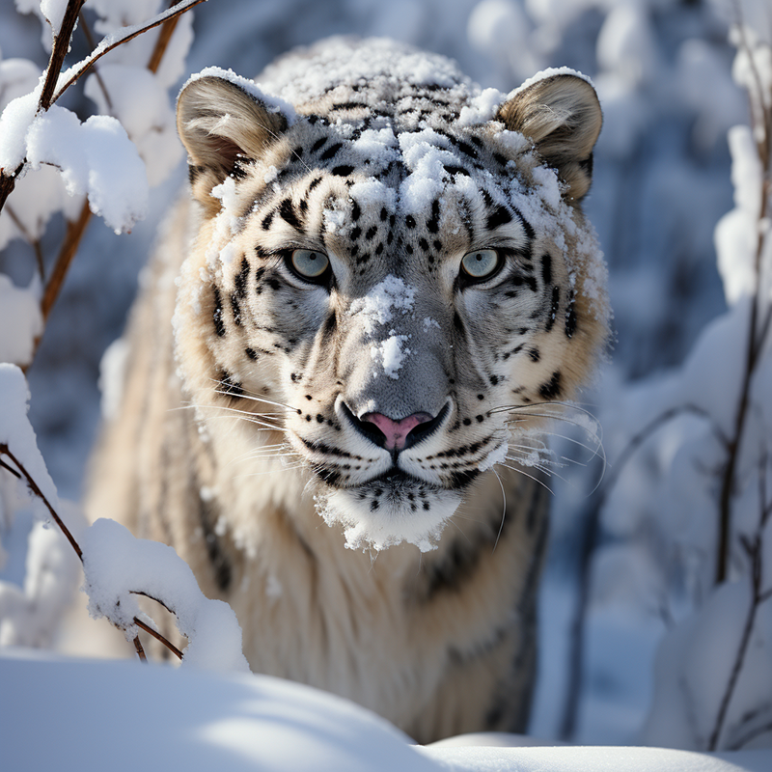

BIO DATA EXTRACTION
Otmani Ilyass & Saoud Yahya
Animal NER on Scientific Articles
June, 10, 2025

Slide 2
Content
01
02
03
04
05
Intro & Subject
Methodology & Innovation
Technical Core
Practical Use & Strengths
Future Work & Wrap-up
02

Slide 3
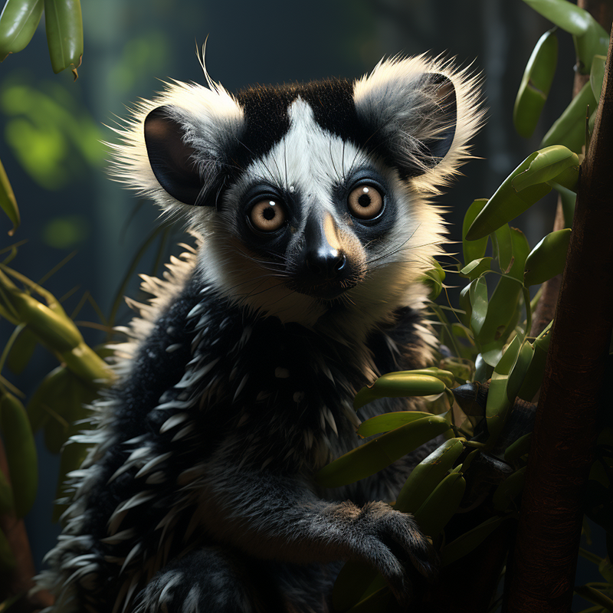
01
Intro & Subject
03

Slide 4
Named Entity Recognition
N.E.R from Scientific PDF Documents using Self-Supervised Entity Relationship Learning through Ultra-Strict Filtering and Contrastive Learning
What & Why & How?
04

Slide 5
Problem Statement
Traditional NER requires massive manually annotated datasets.
Costs around $50,000-$100,000 per domain-specific dataset.
Takes 6-12 months for expert annotation.
The Annotation Data Crisis
05
https://www.linkedin.com/pulse/domain-specific-slms-strategic-alternative-large-language-hijazi-ghczf

Slide 6
Traditional Methods
Rule-Based System
Traditional Machine Learning
Early Neural Approaches
Standard Transformer Models
06

Slide 7
Traditional Challenges
Traditional Machine Learning requires feature engineering with poor performance on S.T.
Rule-Based System
requires rules with no semantic relations.
Early Neural Approaches requires supervised learning
& cannot generalize across disciplines.
Standard Transformers
are computationally expensive & miss entity relations.
07

Slide 8
Problem Statement
Traditional NER requires massive manually annotated datasets.
Costs around $50,000-$100,000 per domain-specific dataset.
Takes 6-12 months for expert annotation.
The Annotation Data Crisis
08
https://www.linkedin.com/pulse/domain-specific-slms-strategic-alternative-large-language-hijazi-ghczf

Slide 9
02
Methodology & Innovation
09

Slide 10
Data Collection & Scraping
Even with annotated data, there is no guarantee it will work for a given problem; that's why we opted for..."
Self-Supervised Learning
10

Slide 11
Project Innovation
Entity Extraction: Identify and extract key named entities from scientific papers.
Create Entity Relation : Establish semantic relationships between extracted entities.
Dataset Output: Structured output containing entities and their interrelations.
Usage of Self-Supervised Network: Leverage previous representation to pre-train models for downstream NLP tasks.
Production Ready Tasks: Deploy scalable models for real-world applications with improved performance.
11

Slide 12
03
Technical Core
12

Slide 13
Important Implementation
&
Self Supervised Learning
Contrastive
Learning
13

Slide 14
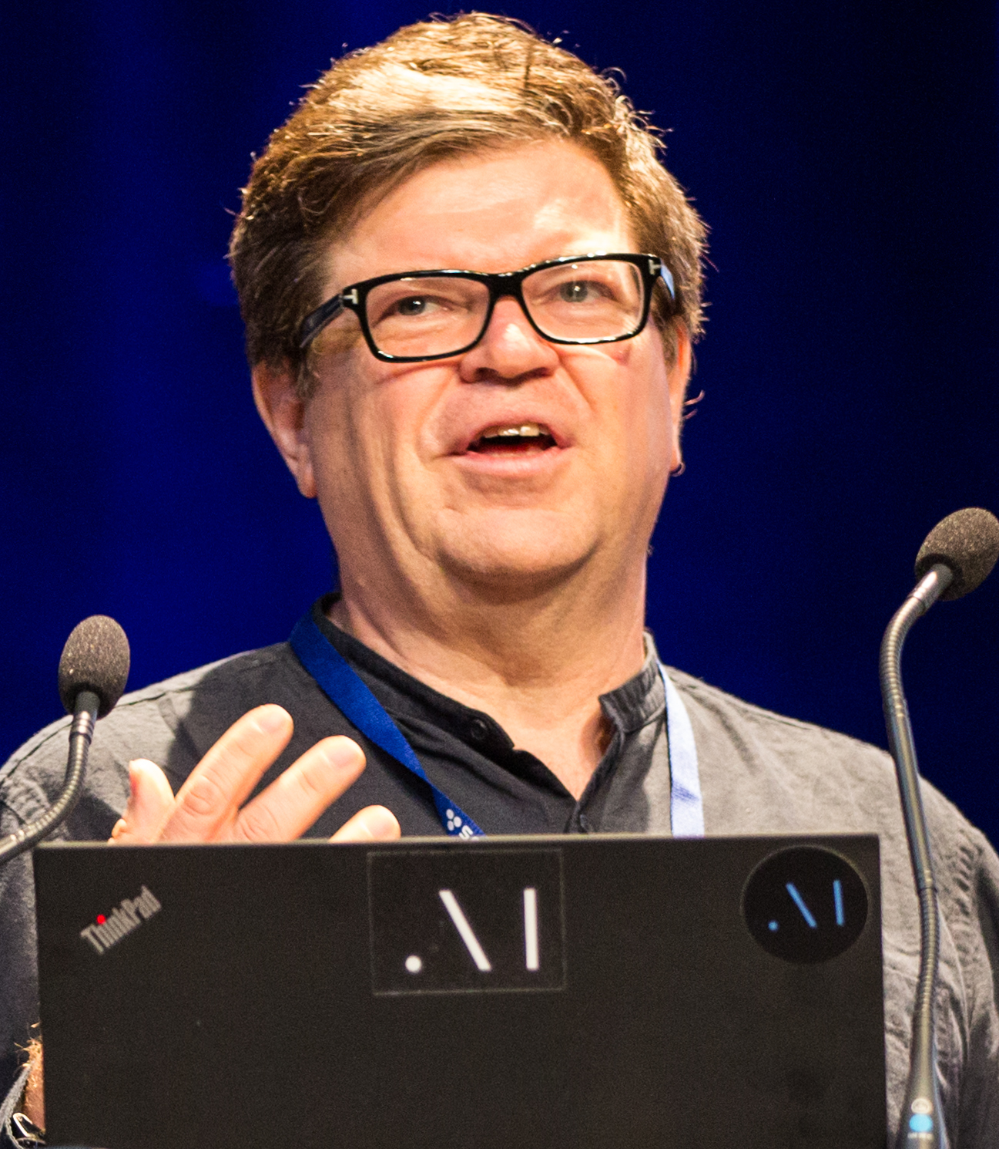
Self Supervised
“I think Self Supervised Methods that use multiple criteria are going to be the main method to pre-train neural nets before training them on any task.”
YANN LECUN
14

Slide 15
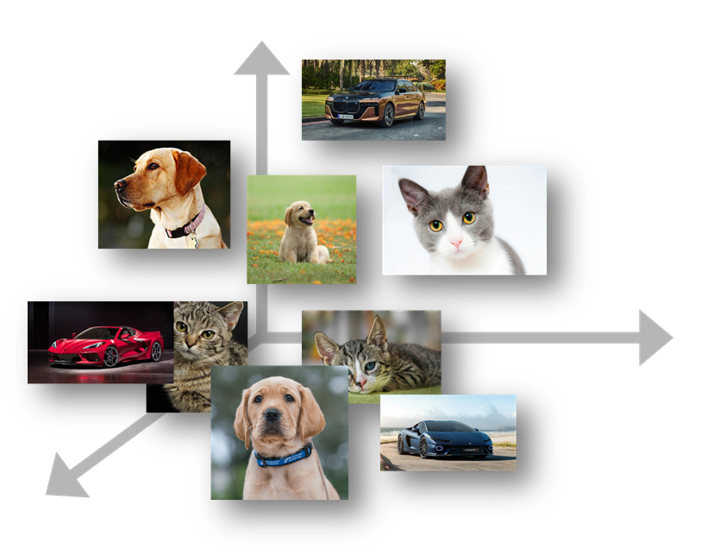
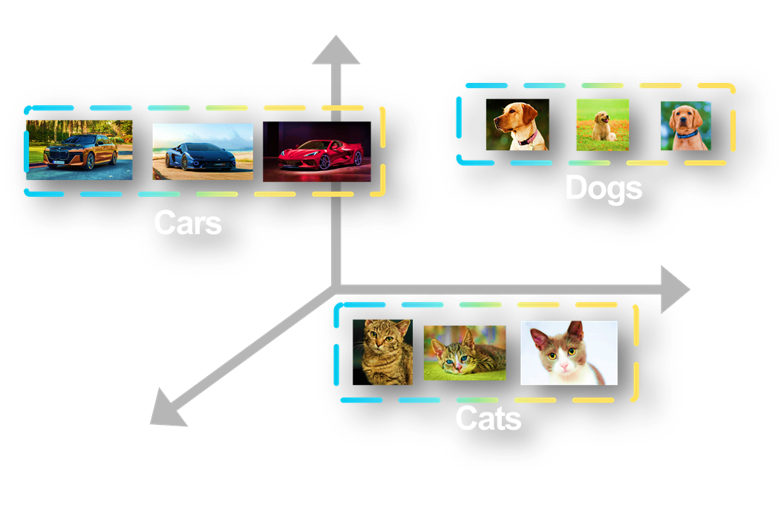
Constrative Learning
Contrastive
Learning
Non Contrastive Learning
15

Slide 16
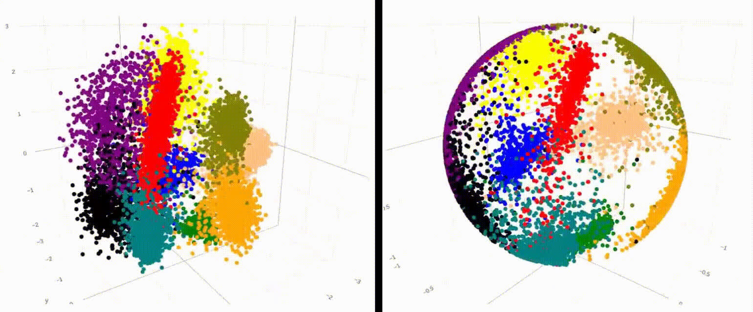
Constrative Representation
https://weaviate.io/blog/what-is-agentic-rag
16

Slide 17
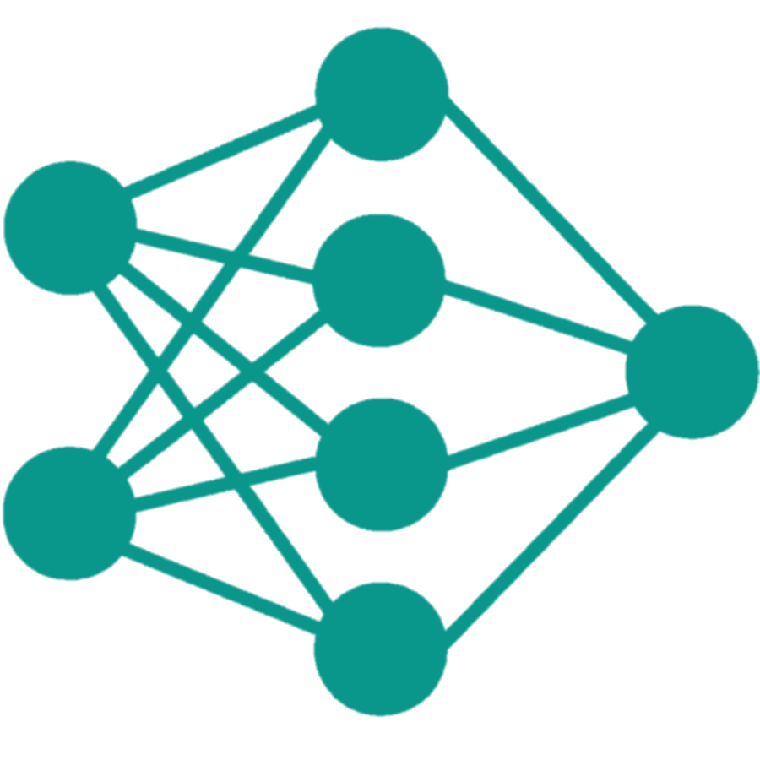
Upstream Training
Contrastive
Representation
Self Aware Relation Encoder
17

Slide 18
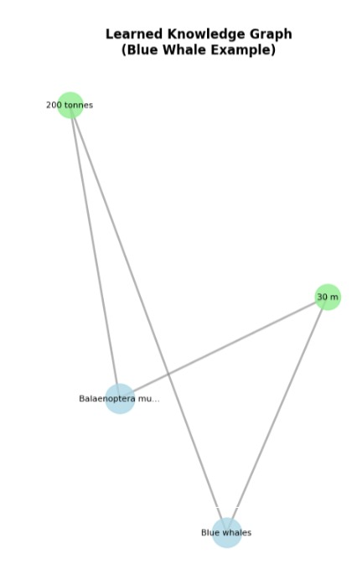
Downstream Training
Self Aware Relation Encoder
Downstream Task
15

Slide 19
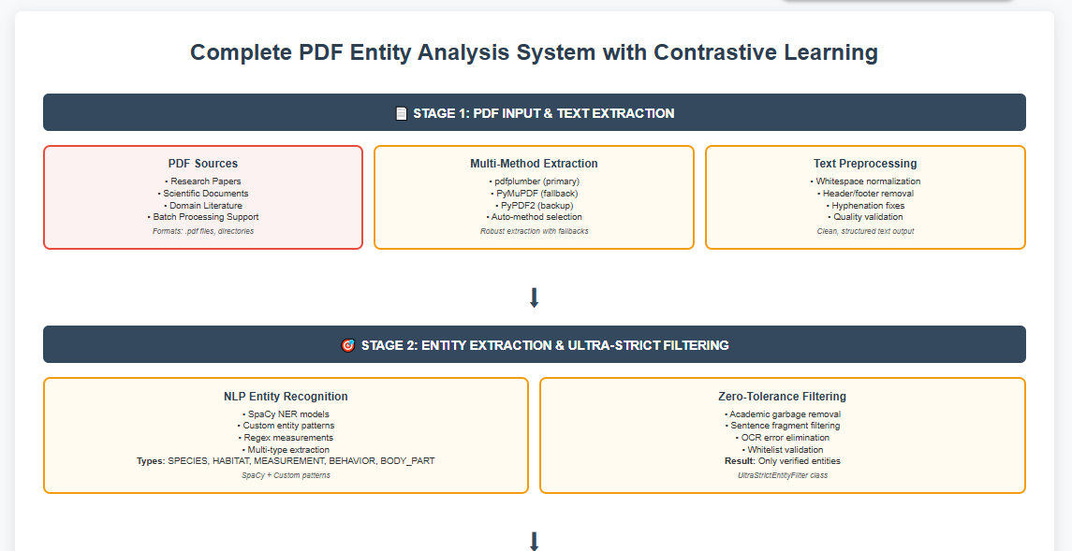
Canvas Pipeline
18
file:///C:/Users/pc/Downloads/full_system_canva_diagram2.html

Slide 20
Results & Evaluation (Downstream Task)
Task | Entity Type Prediction | Relationship Classification | Semantic Search Quality | Question Anwsering Success
Constrative Learning | 0.235 | 0.800 | 0.244 | 0.600
BERT sentence | 0.625 | 0.750 | 0.888 | 0.600
BERT base | 0.875 | 0.750 | 0.898 | 0.600
Roberta | 0.562 | 0.750 | 0.999 | 0.600
19

Slide 21
04
Practical Use & Strengths
20

Slide 22
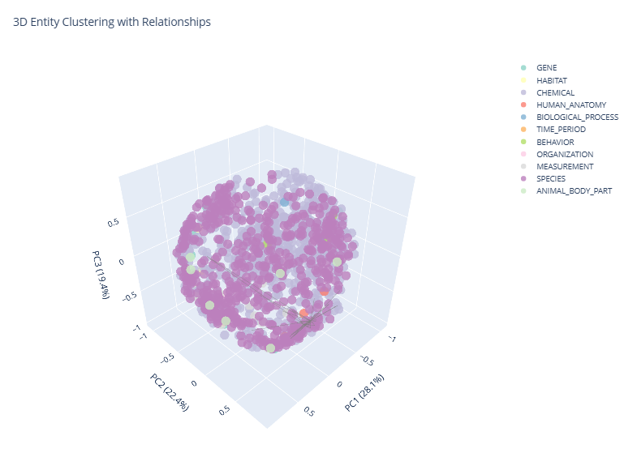
Visualization
file:///C:/Users/pc/Downloads/3d_clusters%20(2).html

Slide 23
State of the Art
VS
Our Approach
State of the Art
Self Supervised & Rule based with Semantic Entity Relation Building instead of Annotation.
Meaning LLM & Transformer Models that use attention mechanism.
21

Slide 24
05
Future Work & Wrap-up
22

Slide 25
Future Work & Limitations
Being Rule Based, it requires tons of rules & the contrastive approach can lead to anomalies in metrics.
Hybrid Approach or Multi-Attention Heads
23

Slide 26
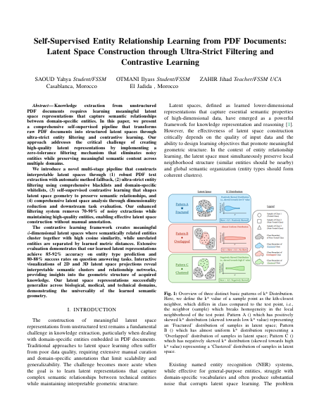
Scientific Paper
This paper focuses on extracting knowledge from unstructured PDFs by creating high-quality latent representations of entities.
It combines robust PDF parsing, strict noise filtering, and self-supervised contrastive learning to structure messy document data—without manual labels.
24

Slide 27
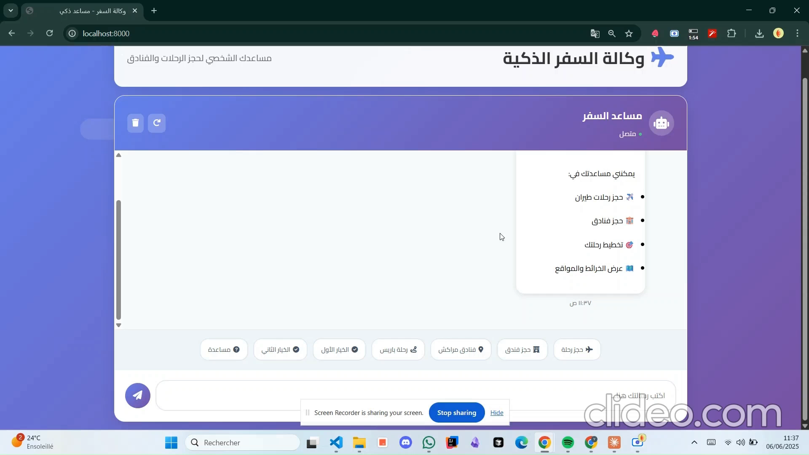
RASA Live Demo
25
Rasa Smart Flight Booking by Otmani Ilyass & Saoud Yahya

Slide 28
BIO DATA EXTRACTION
Thank for your Attention
Otmani Ilyass & Saoud Yahya
Animal NER on Scientific Articles
June, 10, 2025

